Slide 1
Practical R in the London Market
Fiachra McLoughlin, Ed Tredger
UMACS
Underwriting Management and Actuarial Consultancy Services
15 July 2013
U.M.A.C.S.
Underwriting Management and Actuarial Consultancy Services
Managing for Profit...
Notes:
Fiachra

Slide 2
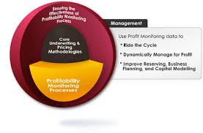
Overview
Brief into to UMACS;
Why does UMACS use R?
Case studies;
Practical barriers to R usage in the London Market
The future of R in pricing
U.M.A.C.S.
Underwriting Management and Actuarial Consultancy Services
www.umacs.co.uk
Managing for Profit...

Slide 3

Who are UMACS?
UMACS has technical expertise in the London Market, but strong focus on practical solutions which deliver bottom line value for the business.
London Market actuarial consultancy
Set up in 2007 by Tony Jones and Fiachra McLoughlin
Expanded to14 people in 2013, covering a range of pricing, capital modelling and reserving projects for Lloyds syndicates, brokers and International Reinsurers
Emphasis on delivering bottom line results through technical expertise and a strong focus on practical solutions
R is a close fit for many UMACS projects and our clients
U.M.A.C.S.
Underwriting Management and Actuarial Consultancy Services
www.umacs.co.uk
Managing for Profit...
Notes:
Fiachra

Slide 4
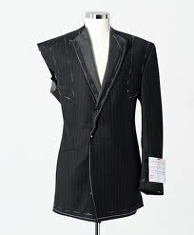

Why does UMACS use R?
UMACS uses R to deliver cutting edge techniques in a practical way
R is fast e.g. Excel simulation models, running reports
R is portable (both in terms of code and software)
R can be easier to follow than an Excel sheet or proprietary software (R is not a black box)
R can draw from others work e.g. internal (functions/modules) and packages (actuar, ggplot, ChainLadder)
R is free
R can do things other software can not and is highly bespoke
R is just as useful for quick calculations as large, formal processes
Vs
U.M.A.C.S.
Underwriting Management and Actuarial Consultancy Services
www.umacs.co.uk
Managing for Profit...
Notes:
Thank Fiachra - Aim of the talk is to give a flavour of our experiences in applying R across a range of well-known clients in the London Market

Slide 5
UMACS Case Studies
Real world case studies
Pricing PD/BI example – dealing with complex coverages
Capital - Stoch reserving (res risk), ELT simulation, fitting dist e.g. SHELF, expert
RI options - explore different options quickly
LCM returns and cat modelling
Automated MI reports e.g. Benchmark pricing
Using R as an Excel add-in
U.M.A.C.S.
Underwriting Management and Actuarial Consultancy Services
www.umacs.co.uk
Managing for Profit...
Notes:
To give a quick overview of the range of applications we have been involved in – there is vast scope for more!
Will speak about a couple of these in more detail – Pricing PD/BI in particular

Slide 6
UMACS Case Studies
Real world case studies
Pricing PD/BI example – dealing with complex coverages
Capital - Stoch reserving (res risk), ELT simulation, fitting dist e.g. SHELF, expert
RI options - explore different options quickly
LCM returns and cat modelling
Automated MI reports e.g. Benchmark pricing
Using R as an Excel add-in
U.M.A.C.S.
Underwriting Management and Actuarial Consultancy Services
www.umacs.co.uk
Managing for Profit...

Slide 7
UMACS Case Studies
Example 1 - ELT simulation
U.M.A.C.S.
Underwriting Management and Actuarial Consultancy Services
www.umacs.co.uk
Managing for Profit...
Notes:
First example is Cat modelling using an RMS Event Loss Table (ELT)
List of events, with associated frequency of each event and parameters defining the distribution of losses from that event per class
As well as defining the correlation of severity across classes

Slide 8
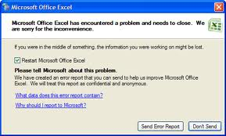
UMACS Case Studies
Example 1 - ELT simulation
U.M.A.C.S.
Underwriting Management and Actuarial Consultancy Services
www.umacs.co.uk
Managing for Profit...
Notes:
Tried this in Excel…

Slide 9
UMACS Case Studies
Example 1 - ELT simulation
#STEP 2 - running the simulation to get gross losses
data <-read.csv('C:\\Users\\edward.UMACS\\Desktop\\LCM Q2\\07May2013.csv', header=TRUE)
gross <- multi_elt(data, n=n_sims)
U.M.A.C.S.
Underwriting Management and Actuarial Consultancy Services
www.umacs.co.uk
Managing for Profit...
Notes:
So we wrote an R function which runs the simulation in a few lines…

Slide 10
UMACS Case Studies
Example 1 - ELT simulation
Region | Peril | Class | Year | Gross | Net | Final Net
UC | QK | DF | 1 | 46 | 46 | 46
UC | QK | DF | 2 | 307,682 | 307,682 | 307,682
UC | QK | DF | 3 | 28,077 | 28,077 | 28,077
UC | QK | DF | 4 | 5,883,232 | 5,000,000 | 5,176,646
UC | QK | DF | 5 | - | - | -
UC | QK | DF | 6 | - | - | -
UC | QK | DF | 7 | - | - | -
UC | QK | DF | 8 | - | - | -
UC | QK | DF | 9 | - | - | -
UC | QK | DF | 10 | - | - | -
UC | QK | DF | 11 | - | - | -
UC | QK | DF | 12 | 0 | 0 | 0
UC | QK | DF | 13 | 343,970 | 343,970 | 343,970
UC | QK | DF | 14 | - | - | -
AEP and OEP results
By class, by peril
Mean, different return periods
Gross/Net/Final Net
RI utilisation, ratios
and exhaustion
Excel – 2 days
R – 30 seconds
U.M.A.C.S.
Underwriting Management and Actuarial Consultancy Services
www.umacs.co.uk
Managing for Profit...
Notes:
To simulate Gross losses takes c.30 seconds using 50k sims – including reading in data and post-processing

Slide 11
Pricing example
Problem – how do we price for correlated perils with a common limit/deductible?
Can become very convoluted in Excel trying to apply First Loss scales to account for the correlations…
Simulation a better approach
U.M.A.C.S.
Underwriting Management and Actuarial Consultancy Services
www.umacs.co.uk
Managing for Profit...
Notes:
Second example is a complicated pricing situation – a single limit being applied to correlated perils

Slide 12
Pricing example
Problem – how do we price for correlated perils with a common limit/deductible?
Can become very convoluted in Excel trying to apply First Loss scales to account for the correlations…
Simulation a better approach
U.M.A.C.S.
Underwriting Management and Actuarial Consultancy Services
www.umacs.co.uk
Managing for Profit...
Notes:
Example of inputs – 10 locations, each with a different sum insured, PML, frequency and severity (for both PD and BI) and a different correlation between PD and BI

Slide 13
Pricing example
Two correlated perils (PD and BI) with a common policy limit
Each has its own TIV, MPL, freq and severity distribution
We run 100k sims and correlate the distributions, then apply the policy limit to the sum of the losses
Outputs show individual (marginal) freq and severity as well as combined FGU and loss to the layer
Accounting for the correlation structure is very hard to achieve without simulation
VBA simulations are much longer, verbose and the statistical abilities more limited
U.M.A.C.S.
Underwriting Management and Actuarial Consultancy Services
www.umacs.co.uk
Managing for Profit...

Slide 14
Pricing example
Two correlated perils (PD and BI) with a common policy limit
Each has its own TIV, MPL, freq and severity distribution
We run 100k sims and correlate the distributions, then apply the policy limit to the sum of the losses
Outputs show individual (marginal) freq and severity as well as combined FGU and loss to the layer
Accounting for the correlation structure is very hard to achieve without simulation
VBA simulations are much longer, verbose and the statistical abilities more limited
#1. Create list of correlation matrices
S <- lapply(rankCorrel,CorrelMatrix2way)
#List of paired gaussian variables
AB <- mapply(rmvnorm,mean=list(c(0,0)),sig=S,n=N,SIMPLIFY=FALSE)
#Map back to [0,1]x[0,1]
U <- lapply(AB,pnorm)
These 3 lines do 100k sims of paired rank-correlated variables, for each location, using a Gaussian Copula in <1 second
U.M.A.C.S.
Underwriting Management and Actuarial Consultancy Services
www.umacs.co.uk
Managing for Profit...
Notes:
Example shows how elegant R solutions can be – this is the key point here!
A very complicated example can be surprisingly concise in R code e.g. the mappy function does a lot of work here…

Slide 15
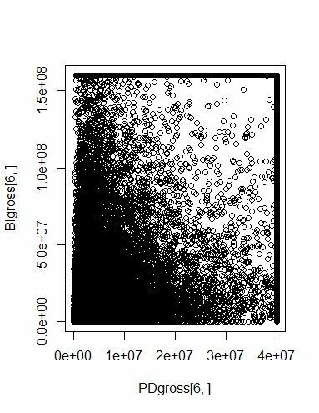
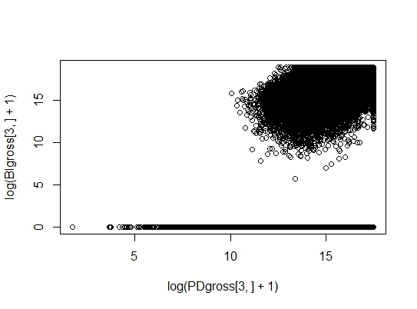
Pricing example
U.M.A.C.S.
Underwriting Management and Actuarial Consultancy Services
www.umacs.co.uk
Managing for Profit...
Notes:
Gross losses shown here (with some correlation) – right hand side on a log-log scale

Slide 16
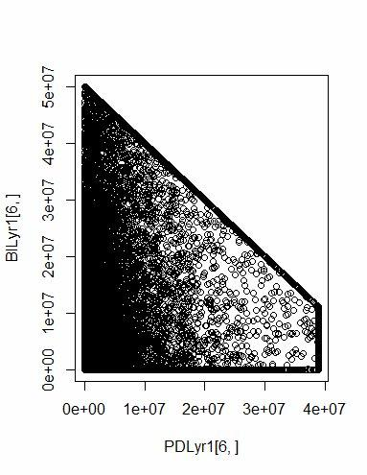
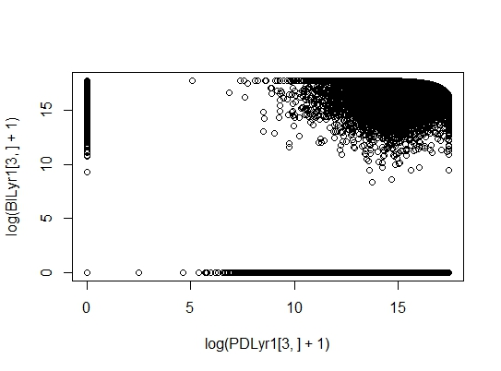
Pricing example
U.M.A.C.S.
Underwriting Management and Actuarial Consultancy Services
www.umacs.co.uk
Managing for Profit...
Notes:
After the limits have been applied

Slide 17
Fitting to expert judgement
User is prompted for severity and frequency percentiles and other inputs
n_sev_tmp <- readline(prompt="How many severity percentiles do you have? ")
U.M.A.C.S.
Underwriting Management and Actuarial Consultancy Services
www.umacs.co.uk
Managing for Profit...
Notes:
Want to show this example of interactively fitting distributions for severity/frequency then simulating gross/net losses with max line size, RI terms

Slide 18
Fitting to expert judgement
User is prompted for severity and frequency percentiles
n_sev_tmp <- readline(prompt="How many severity percentiles do you have? ")
R fits a freq severity model e.g. Neg Binomial and Severity from a selection (LogNormal/Pareto/GPD/Gamma etc) and simulates 100k simulations under the supplied terms
sev <- fit_sev(sev_p, sev_q)
U.M.A.C.S.
Underwriting Management and Actuarial Consultancy Services
www.umacs.co.uk
Managing for Profit...

Slide 19
Fitting to expert judgement
User is prompted for severity and frequency percentiles
n_sev_tmp <- readline(prompt="How many severity percentiles do you have? ")
R fits a freq severity model e.g. Neg Binomial and Severity from a selection (LogNormal/Pareto/GPD/Gamma etc) and simulates 100k simulations under the supplied terms
sev <- fit_sev(sev_p, sev_q)
The user is shown the distribution of gross/net losses e.g. mean and 99.5th to check the inputs
hist(rfrechet(10000,sev_params[1], sev_params[2], sev_params[3]), main="Fitted Frechet severity distribution")
readline(prompt = “Do you want to change your severity inputs?”)
This runs in c. 2 seconds and provides an interactive method of validating Expert judgement for capital models
U.M.A.C.S.
Underwriting Management and Actuarial Consultancy Services
www.umacs.co.uk
Managing for Profit...

Slide 20

Barriers to Entry - skills
U.M.A.C.S.
Underwriting Management and Actuarial Consultancy Services
www.umacs.co.uk
Managing for Profit...
Notes:
Moving on the 4th part of our talk now – barrier to entry
R more difficult to learn than most packaged software – but not more difficult than some actuarial e.g. remetrica or certainly igloo
Voltaire – I wrote a long letter since I didn’t have time to write a short letter

Slide 21

Barriers to Entry - IT
U.M.A.C.S.
Underwriting Management and Actuarial Consultancy Services
www.umacs.co.uk
Managing for Profit...
Notes:
IT can be reluctant to install it, downloading packages, C drive access

Slide 22




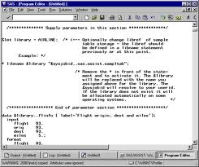
Barriers to Entry – Incumbent advantage
U.M.A.C.S.
Underwriting Management and Actuarial Consultancy Services
www.umacs.co.uk
Managing for Profit...
Notes:
Solutions already exist – albeit in a wide range of different softwares!

Slide 23
Overcoming the barriers
Gaining the skills
Graduates increasingly have R skills – if you ask for them!
R consultants e.g. Mango solutions
Actuarial consultants skilled in R e.g. UMACS
LondonR evenings
Culture that encourages learning – CPD!
Books e.g.
U.M.A.C.S.
Underwriting Management and Actuarial Consultancy Services
www.umacs.co.uk
Managing for Profit...

Slide 24
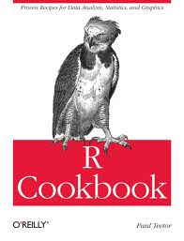
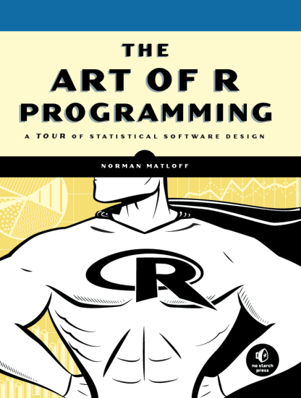
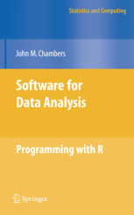
Overcoming the barriers
Gaining the skills
Graduates increasingly have R skills – if you ask for them!
R consultants e.g. Mango solutions
Actuarial consultants skilled in R e.g. UMACS
LondonR evenings
Culture that encourages learning – CPD!
Books e.g.
Beginner
Intermediate
Advanced
U.M.A.C.S.
Underwriting Management and Actuarial Consultancy Services
www.umacs.co.uk
Managing for Profit...

Slide 25

Overcoming the barriers
Can we trust R?
Open source is not wikipedia…
Open Source has no theoretical limits to validation
Core development team and contributors arguably largest skills base in statistical software
Wide range of sophisticated users - the biggest players in academia, pharma, finance use R.
You should test all software. R is set up to be testable!
U.M.A.C.S.
Underwriting Management and Actuarial Consultancy Services
www.umacs.co.uk
Managing for Profit...
Notes:
John Chambers refers to developing trustworthy software as the Prime Directive

Slide 26

Overcoming the barriers
Can we trust R?
Open source is not wikipedia…
Open Source has no theoretical limits to validation
Core development team and contributors arguably largest skills base in statistical software
Wide range of sophisticated users - the biggest players in academia, pharma, finance use R.
You should test all software. R is set up to be testable!
Who do you call if R breaks?
U.M.A.C.S.
Underwriting Management and Actuarial Consultancy Services
www.umacs.co.uk
Managing for Profit...

Slide 27
Overcoming the barriers
Can we trust R?
Open source is not wikipedia…
Open Source has no theoretical limits to validation
Core development team and contributors arguably largest skills base in statistical software
Wide range of sophisticated users - the biggest players in academia, pharma, finance use R.
You should test all software. R is set up to be testable!
Who do you call if R breaks?
Can we sue R?
U.M.A.C.S.
Underwriting Management and Actuarial Consultancy Services
www.umacs.co.uk
Managing for Profit...

Slide 28
Overcoming the barriers
Excel warranty
NO SUPPORT SERVICES. Microsoft is not obligated to provide maintenance, technical or other support, or updates to you for the software.
DISCLAIMER OF WARRANTY. THE SOFTWARE IS LICENSED “AS IS” AND WITH ALL FAULTS. WE GIVE NO EXPRESS WARRANTIES, GUARANTEES OR CONDITIONS. YOU MAY HAVE ADDITIONAL CONSUMER RIGHTS UNDER YOUR LOCAL LAWS WHICH THIS AGREEMENT CANNOT CHANGE. TO THE EXTENT PERMITTED UNDER YOUR LOCAL LAWS, WE EXCLUDE IMPLIED WARRANTIES OF MERCHANTABILITY, FITNESS FOR A PARTICULAR PURPOSE, AND NON-INFRINGEMENT.
LIMITATIONS ON AND EXCLUSIONS OF DAMAGES. YOU CAN RECOVER FROM MICROSOFT AND ITS SUPPLIERS ONLY DIRECT DAMAGES UP TO US$5.00. YOU CANNOT RECOVER ANY OTHER DAMAGES, INCLUDING CONSEQUENTIAL, LOST PROFITS, SPECIAL, INDIRECT OR INCIDENTAL DAMAGES.
U.M.A.C.S.
Underwriting Management and Actuarial Consultancy Services
www.umacs.co.uk
Managing for Profit...

Slide 29
Overcoming the barriers
SAS warranty
DISCLAIMER OF WARRANTY. THE SERVICE AND SOFTWARE ARE MADE AVAILABLE TO YOU BY SAS AND ITS LICENSORS "AS IS" WITHOUT ANY WARRANTIES, EXPRESS OR IMPLIED, INCLUDING BUT NOT LIMITED TO IMPLIED WARRANTIES OF MERCHANTABILITY AND/OR FITNESS FOR A PARTICULAR PURPOSE, OR ARISING AS A RESULT OF CUSTOM OR USAGE IN THE TRADE OR BY COURSE OF DEALING. SAS MAKES NO WARRANTY THAT THE SERVICE WILL OPERATE ERROR-FREE OR WITHOUT INTERRUPTION OR THAT ANY DATA TRANSMISSIONS TO, FROM OR THROUGH THE SERVICE WILL BE COMPLETELY SECURE. Some jurisdictions do not allow exclusions of warranties, so certain provisions of this section may not apply to you; however, they apply to the greatest extent permitted by applicable law. 6.1 Disclaimer of Actions Caused by, or Under the Control of, Third Parties. You are solely responsible for arranging appropriate connection to the Internet and all related costs for providing the necessary computer and other electronic equipment to access and use the Software and Service. SAS does not guarantee that the Software or Service will meet your requirements or that the Software or Service will be uninterrupted or error-free.
Exclusions of Damages; Limitation of Liability. SAS AND ITS LICENSORS DISCLAIM ANY LIABILITY CONNECTED WITH USE OF THE SERVICE AND SOFTWARE. NEITHER SAS, NOR SAS' LICENSORS ARE LIABLE FOR SPECIAL, INCIDENTAL, INDIRECT, CONSEQUENTIAL, PUNITIVE, OR RELIANCE DAMAGES (ARISING IN TORT, CONTRACT OR OTHERWISE), EVEN IF THEY HAVE BEEN INFORMED OF THE POSSIBILITY OF SUCH DAMAGES OR FOR ANY CLAIM BY ANY OTHER PARTY. THE MAXIMUM AMOUNT YOU MAY RECOVER FOR ANY CLAIM RLEATING TO MATTERS COVERED BY THIS AGREEMENT IS LIMITED TO THE FEES PAID FOR THE SERVICE DURING THE RELEVANT LICENSE PERIOD. THE PARTIES MAKE THESE EXCLUSIONS IN CONSIDERATION OF THE FEES PAID AND LICENSES GRANTED UNDER THE AGREEMENT. SOME JURISDICTIONS D
HAVE BEEN ADVISED OF THE POSSIBILITY OF SUCH DAMAGES.
U.M.A.C.S.
Underwriting Management and Actuarial Consultancy Services
www.umacs.co.uk
Managing for Profit...

Slide 30
The future of R in the London Market
Evolution of Pricing & incorporating R
The ‘Minimum Underwriting Standards’ implemented at Lloyds;
Pricing Actuaries have multiplied (though varied roles);
Catastrophe models become deeply engrained; (LCM etc)
Little resistance to Pricing Models on the underwriting side;
More requests for change and underwriters demand a ‘good’ pricing tool to support their business;
Organisation level ‘platform’ developments with large-scale IT;
Much more visibility at board and exec level.
Core platforms but with flexibility for change & enhancement
Who owns the calculations + code?
Complexity of calculations are increasing significantly?
Visibility + flexibility for change?
Can R provide a useful balance?
U.M.A.C.S.
Underwriting Management and Actuarial Consultancy Services
www.umacs.co.uk
Managing for Profit...

Slide 31

Questions?
Edward.Tredger@umacs.co.uk
Fiachra.McLoughlin@umacs.co.uk
U.M.A.C.S.
Underwriting Management and Actuarial Consultancy Services
www.umacs.co.uk
Managing for Profit...

